Slide 1
Usecases of AI for Network
China Mobile
Xiaoqiu Zhang

Slide 2
Usecases of AI for Network
Matching business intent with network resources
Continuously provide network services to meet business expectations at minimum cost
AI for Network Service
Automatic fault identification and repair
Predictive operation and maintenance
AI for Network Operation
AI for Network Self-Learning
The continuous evolution capability of AI learning can make the entire system smarter

Slide 3
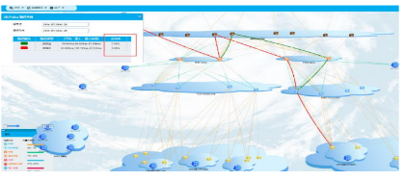
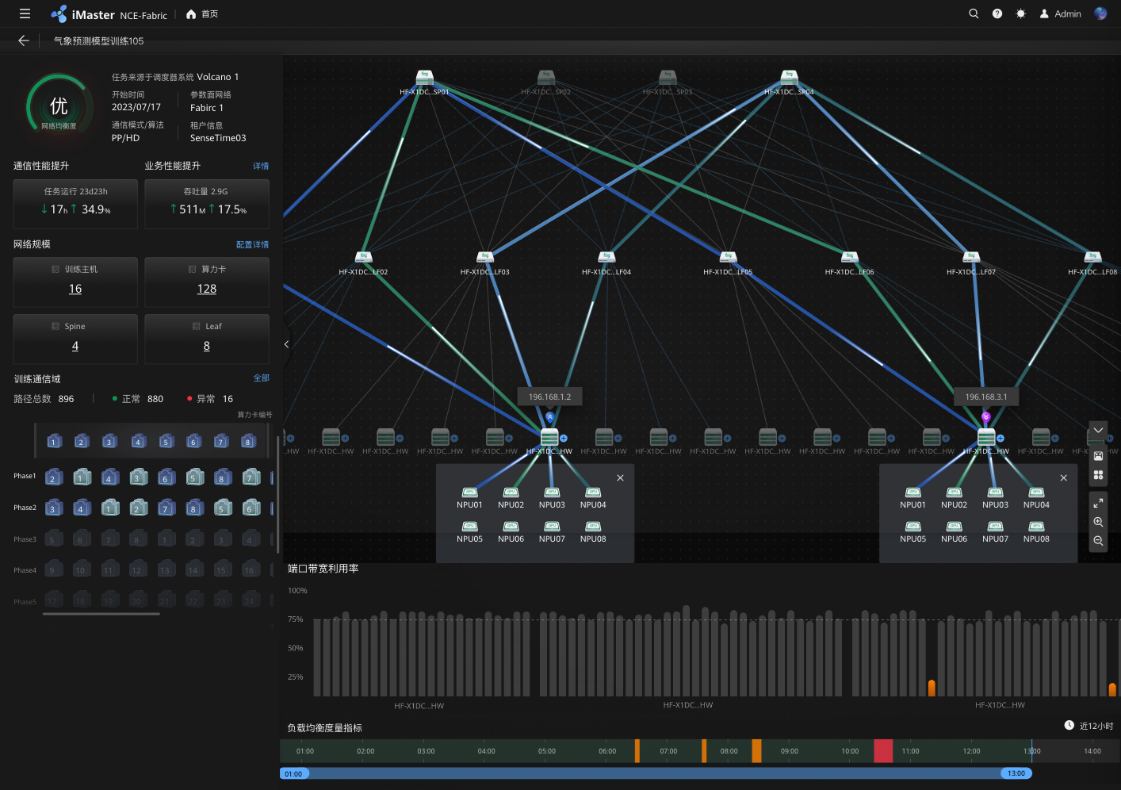
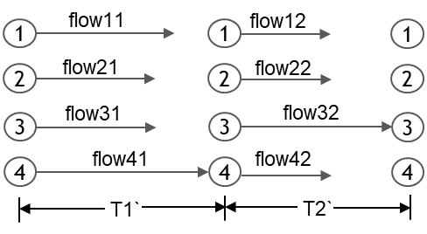
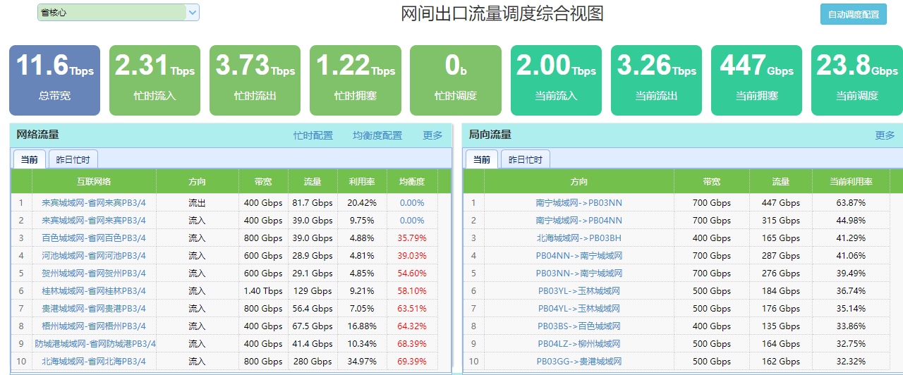
Usecase 1: AI-assisted path calculation and optimization decision
Network Knowledge Base：Accumulate a large amount of operational datas collected during the process of network operations , which can build an operations knowledge base including network quality data.
Traffic Forecast：Modeling analysis and model training for historical traffic, achieving the ability to forecast traffic indicators (periods, peak and off-peak hours)
Path Optimizing：Based on the AI capabilities with the current network status and traffic forecast , calculate the optimal paths and provide relevant adjustment suggestions to assist in routing decision
Network Path Visuelized
Loss/delay/bandwidth Analysis

Slide 4
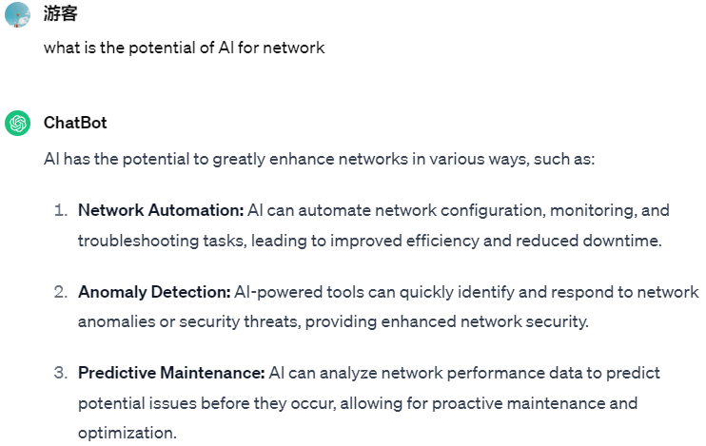



Usecase 2: Intentional Operations and Maintenance
The large amount of operation and maintenance datas can be learned by the GPT large model and summarized through model training and inference to form an O&M knowledge base
Users can input operation and maintenance-related questions, the robot/assistant can accurately understand their intentions through semantic recognition and intelligently generate related response content
Achieve self-service analysis of network quality and improve the efficiency of operation and maintenance work
User Intention
Intention Resolution
Execution result
Task Execution
Knowledge Base
O&M Knowledge Q&A

Slide 5
Usecase 3: Intelligent Network Configuration Generation & Configuration Audit
Configuration Generation: Analyze the requirements of network configuration work orders and understand the configuration intentions through large models, understand the business demands based on the descriptions in the work orders, automatically generate the configuration scripts
Configure AI-related Analysis and Audits: Train historical configuration data, generate configuration models, compare the current network data to be checked, output inspection results, have experts confirm the suspected anomalies detected by the algorithm, and label whether they are abnormal. The types of labeling include: correct, redundant, incorrect, missing, conflict, etc.
Rule Library Auto-Updating: Continuously update the rule library through AI self-learning, automatically learn the configuration rules for new configurations, reduce manual workload, and avoid problems such as improper input and omissions caused by manual operations.

Slide 6






AI-driven Network Framework
Key difference over traditional network architecture is introduction of Intelligence plane, which can be collaborated with control plane and forwarding plane in both global and local views
Management and control plane
Intelligence plane
Intelligent services
Key technology
Data collaboration
Experience awareness
Intelligent scheduling
Optimal resource utilization
Computing power management
Authentication and authorization
NE analysis
Corpus Annotation
Service management
Traffic management
User analysis
Intelligent operations
Fine-tuning Large Models
NE management
Access control
Traffic analysis
Intelligent O&M
Active defense
Predictive failues
Data uploading
Retrieval Augme-
nted Generation
Forwarding plane
Intelligent network
self-learning
Multi-Agents
Application identification
Traffic management and control
Intelligent traffic steering
Security protection
Optimization enhancement
Application signature database
O&M foundation model
Security signature database
Merge large and
small models
Intelligent hardware
Data production

Slide 7
Summary and Future Work
Future research will continue to explore the scenarios, architectures and key technologies of AI for network and network for AI, such as building time-varying source routing paths for elastic dynamic adjustments
Any comments or discussions are welcome

